Slide 1
Filtering in Spatial Domain

Slide 2
Introduction to Spatial Filtering
Filter term in “Digital image processing” is referred to the sub-image.
There are others term to call sub-image such as mask, kernel, template, or window.
The value in a filter sub-image are referred as coefficients, rather than pixels.
Spatial filtering term is the filtering operations that are performed directly on the pixels of an image.

Slide 3
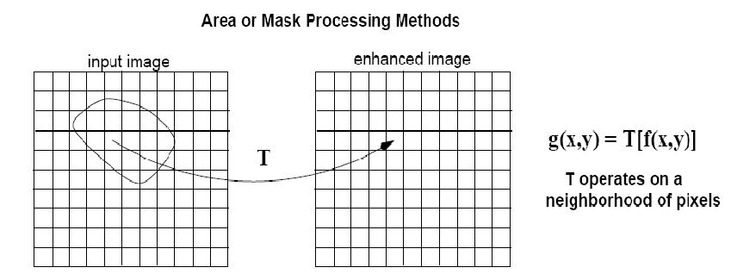
Spatial Filtering
Spatial filtering are defined by:
  A neighborhood.
  A predefined operation that is performed on the pixels inside the neighborhood.

Slide 4
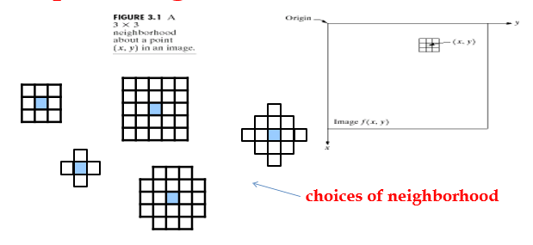
Spatial Neighborhood
Typically, the neighborhood is rectangular and its size is much smaller than that of f(x,y). E.g e.g., 3x3 or 5x5
The process consists simply of moving the filter mask from point to point in an image.
At each point (x,y) the response of the filter at that point is calculated using a predefined relationship.

Slide 5
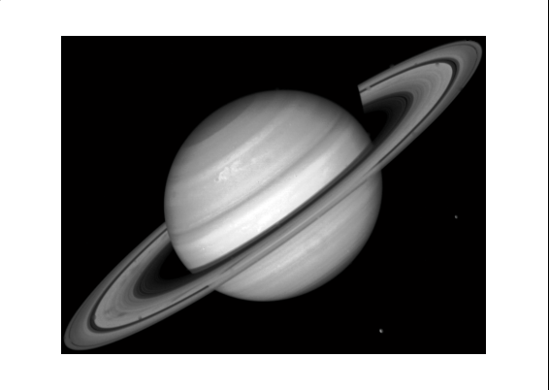
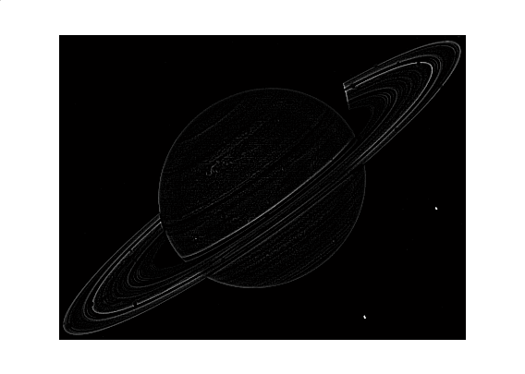
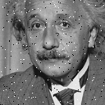

Types of Spatial Filters
Smoothing Spatial Filters.
  Smoothing filters are used for blurring and for noise reduction.
  Sharpening Spatial Filters.
    Highlight fine detail or enhance detail that has been blurred.

Slide 6
Smoothing Spatial Filter
Smoothing filters are used for blurring and noise reduction.
Blurring is used in preprocessing steps to removal of small details from an image prior to object extraction and bridging of small gaps in lines or curves.
Noise reduction can be accomplished by blurring.
Types of Smoothing Filter.
  Linear Filters– operations performed on image pixel.
  Order-Statistics (non-linear)Filters – based on ranking the pixels.

Slide 7
Linear Filters
Linear spatial filter is simply the average of the pixels contained in the neighborhood of the filter mask.
The idea is replacing the value of every pixel in an image by the average of the gray levels in the neighborhood defined by the filter mask.
This process result in an image reduce the sharp transitions in intensities.
Two types of mask used in Linear Filters.
  Averaging filter and Weighted averaging filter

Slide 8
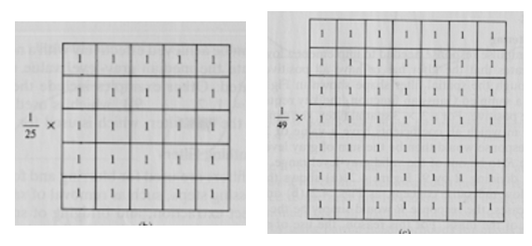
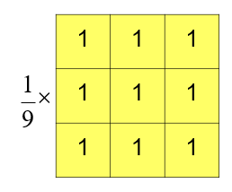
Averaging Linear Filter
A major use of averaging filters is in the reduction of irrelevant detail in image.
mxn mask would have a normalizing constant equal to 1/mn, Its also known as low pass filter.
A spatial averaging filter in which all coefficients are equal is called a box filter.

Slide 9
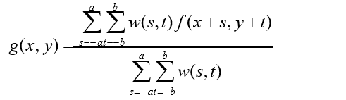
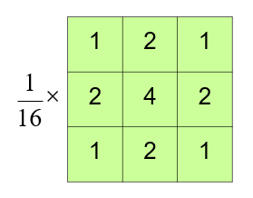
Weighted Averaging Filter
The general implementation for filtering an MxN image with a weighted averaging filter of size m x n is given by the expression.
For complete filtered image apply x = 0,1,2,3……..m-1 and y=0,1,2,3,……..n-1 in the above equation.

Slide 20
Order-Statistics Filter
Order-statistics filters are nonlinear spatial filters.
It is based on ordering (ranking) the pixels contained in the image area encompassed by the filter.
It replaces the value of the center pixel with the value determined by the ranking result.
The filter selects a sample from the window, does not average.
Edges are better preserved than with liner filters Best suited for “salt and pepper” noise.

Slide 21
Types of order-statics filter
Minimum filter.
  Minimum filter selects the smallest value in the window and replace the center by the smallest value.
  Generally used to enhances the dark areas of image.
Maximum filter.
  The maximum filter selects the largest value within of pixel values, and replace the center by the largest value.
  Generally used to enhances the bright areas of image.

Slide 22
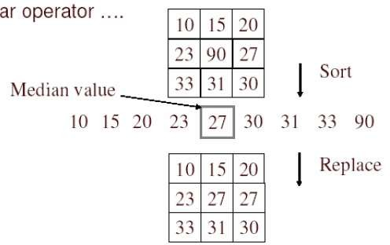
Types of order-statics filter
Median Filter -Three steps to be followed to run a median filter.
  Consider each pixel in the image
  Sort the neighboring pixels into order based upon their intensities
  Replace the original value of the pixel with the median value from the list.

Slide 28
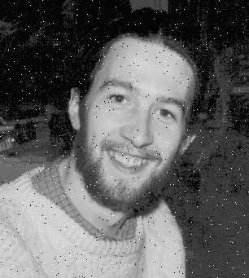
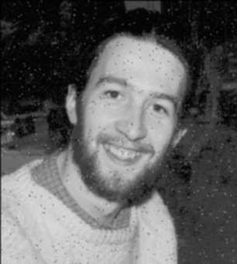

Original image
A linear filter cannot totally eliminate impulse noise, as a single pixel which acts as an intensity spike can contribute significantly to the weighted average of the filter.
Non-linear filters can be robust to this type of noise because single outlier pixel intensities can be eliminated entirely.
Mean filter
Median filter

Slide 29
Sharpening Filters(High pass filter)
To highlight fine detail in an image or to enhance detail that has been blurred, either in error or as a natural effect of a particular method of image acquisition.
Blurring vs. Sharpening
  Blurring/smooth is done in spatial domain by pixel averaging in a neighbors, it is a process of integration.
  Sharpening is an inverse process, to find the difference by the neighborhood, done by spatial differentiation.

Slide 30
Sharpening Filters
The concept of sharpening filter is based on First and second order derivatives.
The strength of the response of a derivative operator is proportional to the degree of discontinuity of the image at the point at which the operator is applied.
Image differentiation - enhances edges and other discontinuities (noise) deemphasizes area with slowly varying gray-level values.

Slide 31
First and second order difference of 1D
The basic definition of the first-order derivative of a one-dimensional function f(x) is the difference
The second-order derivative of a one-dimensional function f(x) is the difference

Slide 32
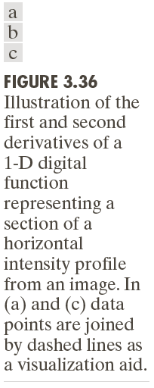

Slide 33
First and Second-order derivative of 2D
when we consider an image function of two variables, f(x, y), at which time we will dealing with partial derivatives along the two spatial axes.
Gradient operator
(linear operator)
Laplacian operator
(non-linear)

Slide 34
Laplacian Filter
As it is a derivative operator, it highlights gray-level discontinuities in an image and it deemphasizes regions with slowly varying gray levels.
Tends to produce images that have grayish edge lines and other discontinuities, all superimposed on a dark, featureless background.
from

Slide 35
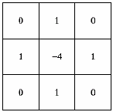
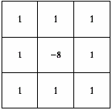
Types of Laplacian Mask

Slide 36
Application of Laplacian Filter
Correct the effect of featureless background - by adding the original and Laplacian image.
if the center coefficient of the Laplacian mask is negative
if the center coefficient of the Laplacian mask is positive

Slide 37
E.g.
a). image of the North pole of the moon
b). Laplacian-filtered image with
c). Laplacian image scaled for display purposes
d). image enhanced by addition with original image
1 | 1 | 1
1 | -8 | 1
1 | 1 | 1

Slide 38
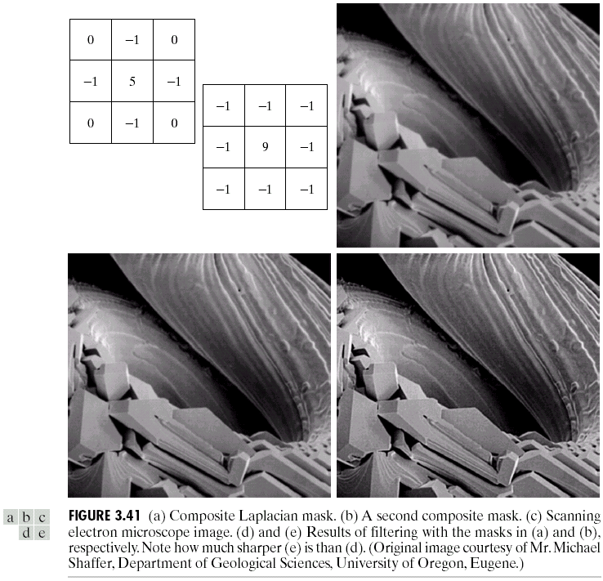
Example

Slide 39
Un-sharp Masking
Subtracting a blurred version of an original image produces sharpening output image.
i.e. sharpened image = original image – blurred image.

Slide 40
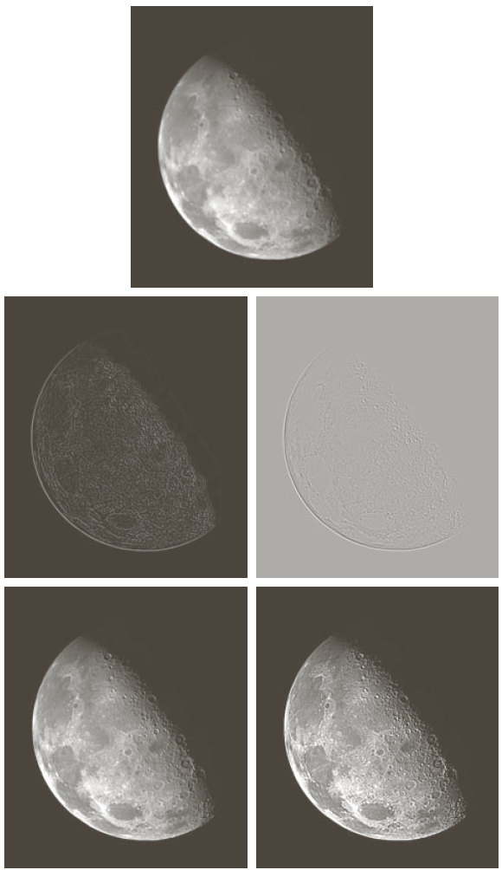

Slide 41
High-Boost Filtering
generalized form of Un-sharp masking with A ≥ 1.

Slide 42
High-boost filtering
if we use Laplacian filter to create sharpen image f_{s}(x,y) with addition of original image

Slide 43
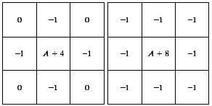
High-boost Masks
A ≥ 1
if A = 1, it becomes “standard” Laplacian sharpening

Slide 44
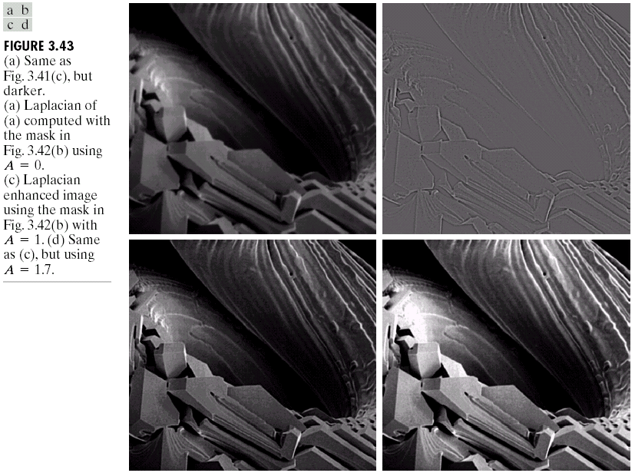
Example

Slide 45
Gradient Operator
first derivatives are implemented using the magnitude of the gradient.
commonly approx.
the magnitude becomes nonlinear

Slide 46
Gradient Mask
z₁ | z₂ | z₃
z₄ | z₅ | z₆
z₇ | z₈ | z₉
simplest approximation, 2x2

Slide 47

Gradient Mask
z₁ | z₂ | z₃
z₄ | z₅ | z₆
z₇ | z₈ | z₉
Roberts cross-gradient operators, 2x2

Slide 48
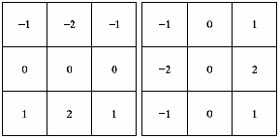
Gradient Mask
z₁ | z₂ | z₃
z₄ | z₅ | z₆
z₇ | z₈ | z₉
Sobel operators, 3x3
the weight value 2 is to achieve smoothing by giving more important to the center point

Slide 49
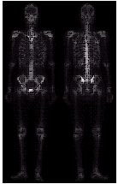
Combining Spatial Enhancement Methods
Want to sharpen the original image and bring out more skeletal detail.
problems: narrow dynamic range of gray level and high noise content makes the image difficult to enhance.

Slide 50
Solution
Using following filters we can enhance the quality.
  Laplacian filter to highlight fine detail.
  gradient filter to enhance prominent edges.
  gray-level transformation to increase the dynamic range of gray levels.

Slide 51
